Slide 1
http://www.skillsusafl.org/

Slide 2
Industrial & Technology Education Updates
Fall 2013 Workshop
Miami Northwestern Senior Auditorium
August 13, 2013
8:00am-3:00pm

Slide 3
WELCOME
Workshop Presenters:
Tom Cummings, Instructional Supervisor
Ralph Bryan, Educational Specialist
Pamela Lopez, Curriculum Support Specialist

Slide 4
Division of Academics, Accountability & School Improvement
Science, Technology, Engineering and Mathematics (STEM)
Notes:
Under a new division, which

Slide 5

Marie Izquierdo, Assistant Superintendent
Division of Academics, Accountability
& School Improvement
Academics Departments
Assessment, Research, and Data Analysis
Office of School Improvement
And STEM

Slide 6
STEM
Cristian Carranza, Administrative Director
Division of Academics, Accountability
& School Improvement
STEM
STEM brings these two departments together:
Department of Career & Technical Education
Department of Mathematics & Science

Slide 7
STEM Vision
Our Vision
Miami-Dade County Public Schools aspires to engage and prepare all our students in Science, Technology, Engineering and Mathematics (STEM) to ensure our community has the next generation of inventors, explorers, innovators and leaders.

Slide 8
STEM Mission
Our Mission
The mission of Miami-Dade County Public Schools STEM is to leverage the expertise and capital of the Department of Career and Technical Education and the Department of Mathematics and Science to increase student achievement in STEM curriculum to enhance career and college readiness.

Slide 9

Always question, Always wonder

Slide 10
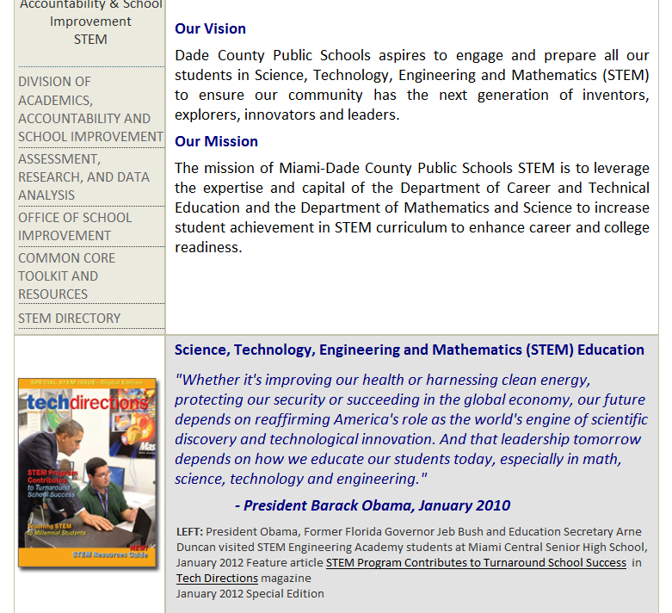
Division links
School Improvement for SIP links
Common Core
STEM directory

Slide 11
STEM Education:
America’s Role
"Whether it's improving our health or harnessing clean energy, protecting our security or succeeding in the global economy, our future depends on reaffirming America's role as the world's engine of scientific discovery and technological innovation.
And that leadership tomorrow depends on how we educate our students today, especially in math, science, technology and engineering."
- President Barack Obama, January 2010

Slide 12
Attributes of a STEM Educated Student
Problem-solvers – define questions and problems, design investigations to gather data, collect and organize data, draw conclusions, and apply understandings to new and novel situations.
Innovators – creatively use science, mathematics, and technology concepts/principles by applying them to the engineering design process.
Inventors – recognize the needs of the world and creatively design, test, redesign, and then implement solutions (engineering process).
Self-reliant –use initiative and self-motivation to set agendas, develop and gain self-confidence, and work within time specified time frames.
Logical thinkers –apply rational and logical thought processes of science, mathematics, and engineering design to innovation /invention.
Technologically literate - explain the nature of technology, develop the skills needed, and apply technology appropriately.
Morrison, Janice, 2006. TIES STEM education monograph series, attributes of STEM education.
Notes:
TIES: Teaching Institute for Excellence in STEM
Author was the recent STEM Advisor to the White House and U.S.D.O.E. and involved with the development of RTTT and Innovate to Educate reform programs.
GOAL – shift from isolated, discrete STEM disciplines to scientific understanding and reasoning.
Transdisciplinary STEM education: teaching from a STEM design perspective.
Problem solvers: According to cognitive learning theorists, play is the pre-cursor to problem-solving and questioning is central to play. Problem solvers argue from evidence – similar to CCSS for Literacy and Mathematical Practices.

Slide 13
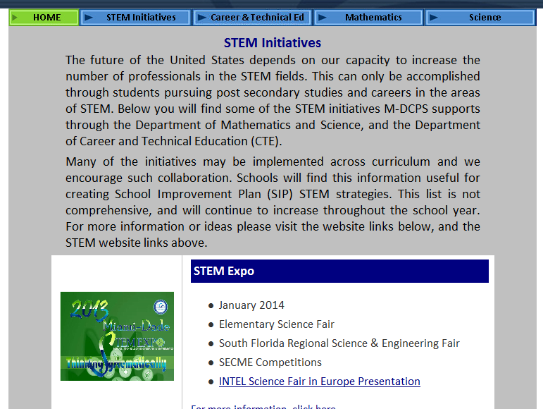
STEM Initiatives for CTE, Mathetics & Science Students

Slide 14
Department of
Career & Technical Education
Dr. Rose L. Martin, Executive Director
Department of Career & Technical Education

Slide 15
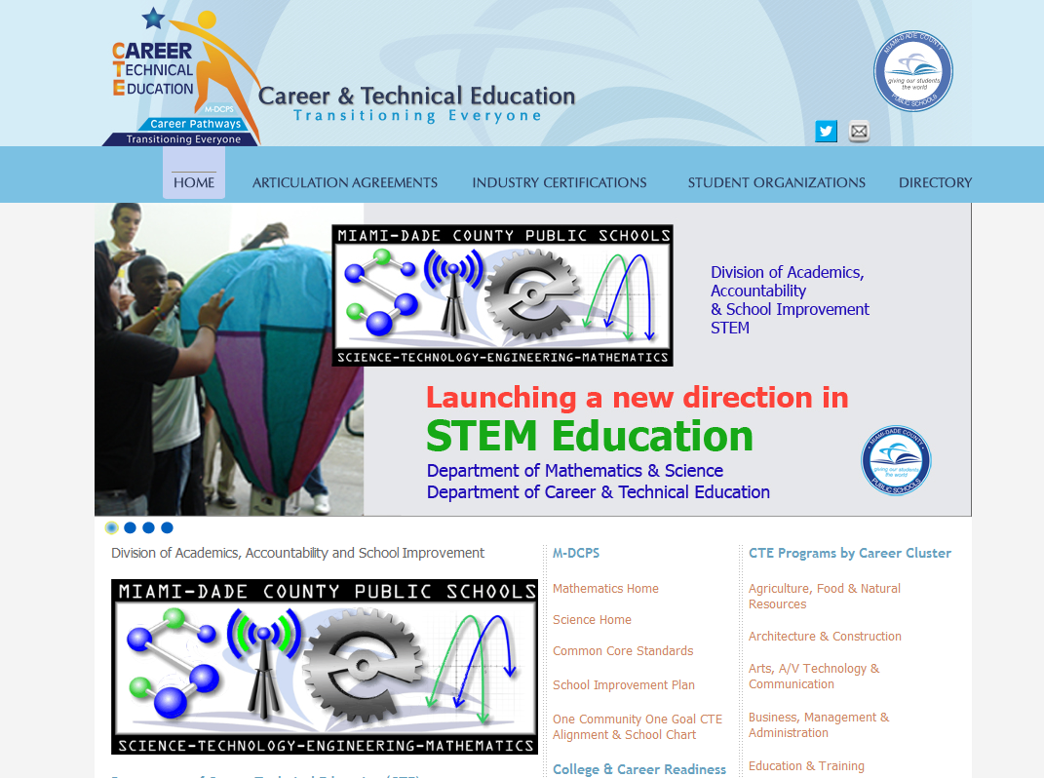
CTE Website http://dcte.dadeschools.net

Slide 16
CTE Home - Top Navigation
Articulation Agreements
  Students Earn College Credit by Completing CTE Programs
Industry Certifications
  2012-2013 Industry Certifications Alignment Report for MDCPS
Student Organizations
  Technology Student Association (TSA) and SkillsUSA
CTE Programs by Career Cluster
  Career Cluster pages describe careers and programs, and link to FL-DOE CTE Curriculum Frameworks

Slide 17
Programs by Career Cluster
Technology Education programs for middle & high school are listed under Engineering & Technology Education cluster.
Industrial Education programs listed under appropriate career cluster.
Select CTE programs are also listed again under STEM
Agriculture, Food & Natural Resources
Architecture & Construction
Arts, A/V Technology & Communication
Business, Management & Administration
Education & Training
Energy
Engineering & Technology Education
Finance
Government & Public Administration
Health Science
Hospitality & Tourism
Human Services
Information Technology
Law, Public Safety & Security
Manufacturing
Marketing, Sales & Services
Science, Technology, Engineering & Mathematics (STEM)
Transportation, Distribution & Logistics

Slide 18
CTE Students With Disabilities
Approx. 6,000 students with disabilities take at least one CTE course annually
Approximately 3,500 in CTE program strands and/or academies
2,000 enrolled in ESE CTE courses taught by certified CTE Program Instructors

Slide 19
CTE Students With Disabilities
100 high school students are dually enrolled at M-DCPS Adult Technical Centers
Modified OCPs available for course completion
Accommodations for instruction and industry certifications
For more information on Curriculum Support, contact Cynthia Guillama at 305-693-3030 or cguillama@dadeschools.net

Slide 20
CTE and the
School Improvement Plan (SIP)

Slide 21
Secondary & Postsecondary– Powerpoints &
Appendix of Resources
http://osi.dadeschools.net

Slide 22
FL-DOE Suggestions
CTE fits within several sections or categories of the School Improvement Plan
  Part I G. Every Teacher Contributes to Reading Improvement – (CTE teachers trained by FL-DOE NGCARPD or NG CATER?
  College and Career Readiness – CTE programs or MS CTE courses
  Expected Improvement Data --- industry certification achieved last year and other data

Slide 23
FL-DOE Suggestions
CTE fits within several sections or categories of the School Improvement Plan
  Number of STEM-related experiences provided for students (e.g. robotics competitions; field trips; science fairs, CTSO Competitions – TSA or Skills USA
  Area 6: Career and Technical Education, example: Students enrolling in one or more CTE courses (Could be listed in both STEM and CTE SIP categories)

Slide 24
Common Core State Standards
Literacy Standards for Technical Subjects
District Resources at:
http://commoncore.dadeschools.net

Slide 25
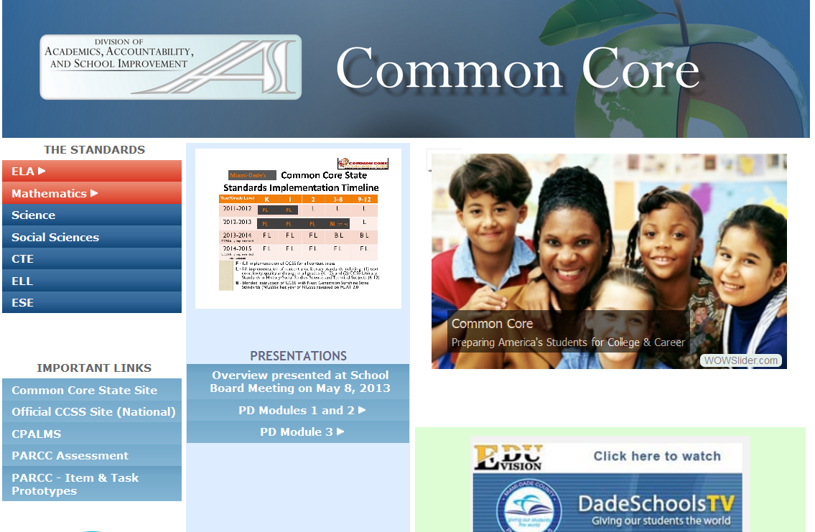

Slide 26
District Common Core Site
Highly recommend review of the two Summer Institute presentations
Reading, Writing Materials and resources posted from district PD presented to CTE instructors
Math & Science resources

Slide 27
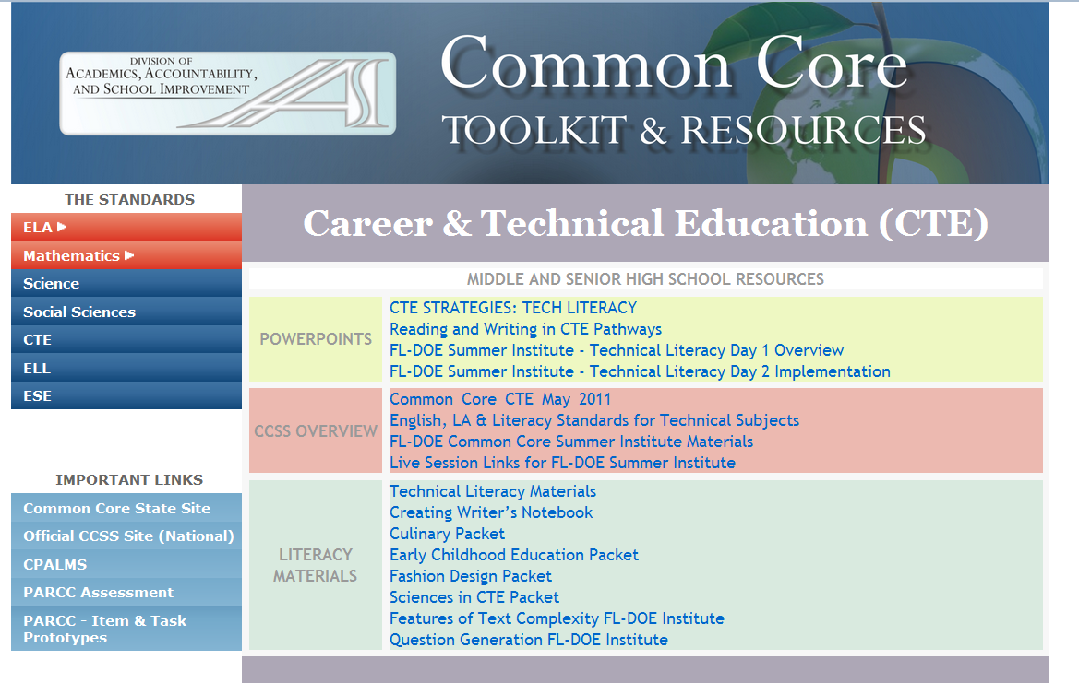

Slide 28

2013 – 14
Common Core Training for CTE
November 8, 2013
February 7, 2014
And also through FACTE-sponsored
online courses dates TBA

Slide 29

http://www.cpalms.org
Search the Common Core Standards
CTE lessons will be posted as developed, but also they look for teacher developed materials – see site for details
Model lessons & Resources for Science (some of which can relate to CTE)
NOTE – eventually the CTE frameworks will be posted on CPALMS

Slide 30

http://www.fldoe.org/schools/ccc.asp
Presentations from last summer Common Core institutes
Videos, sample lessons, rubric examples, etc.

Slide 31
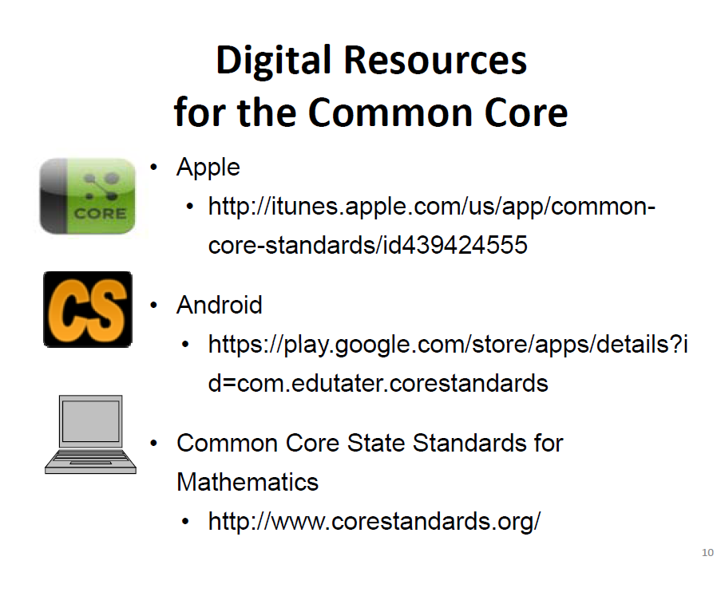

Slide 32


Slide 33
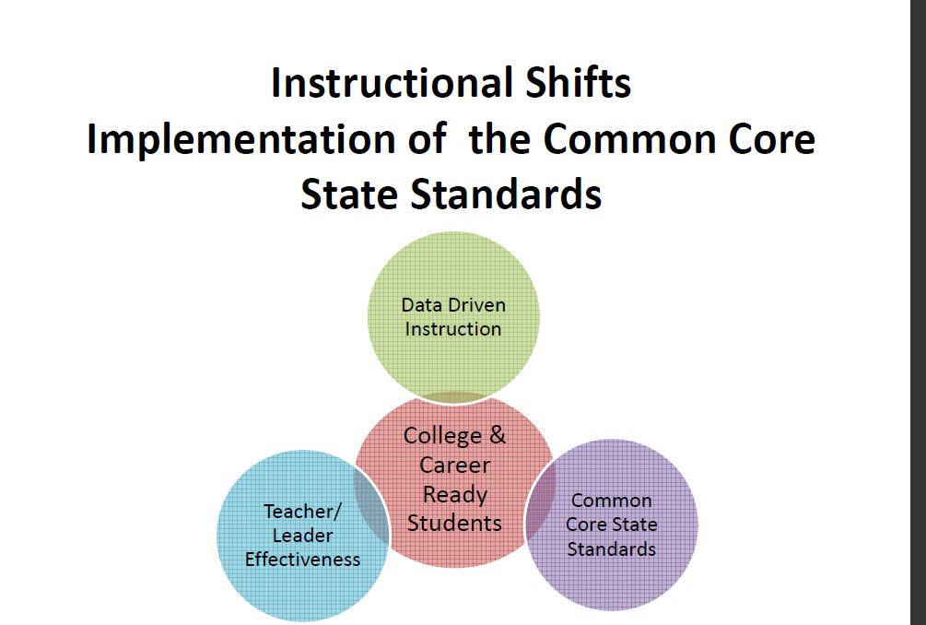

Slide 34
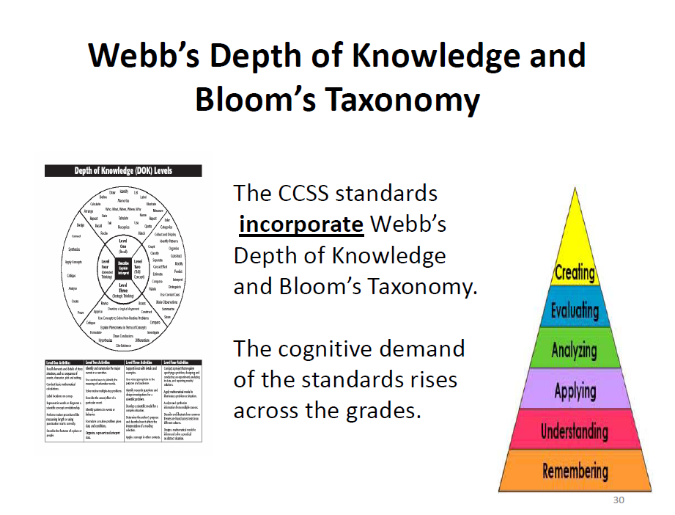

Slide 35



Florida’s Common Core State Standards (CCSS)
Career and Technical Education Strand

Slide 36
CCSS Overview
Who?
• The CCSS were developed and voluntarily adopted by forty‐five states, including the District of Columbia, four territories and the Department of Defense.
What?
• The CCSS are academic standards that define what students need to learn for English/Language Arts (K‐12), Mathematics (K‐12), and Literacy in History/Social Studies, Science and Technical Subjects (6‐12).
When?
• In 2010, Florida’s State Board of Education adopted a new set of academic standards called the Common Core State Standards. These standards will be fully implemented across K‐12 classrooms in the 2014‐15 school year.
Why?
• These new standards enhance the rigor and depth of information that students must learn in school, and focus on preparing students with the essential knowledge and skills needed to be successful in college and careers.

Slide 37
An overview…
The purpose of the CCSS…
To define the English language arts, literacy, and mathematical skills and knowledge students in grades K‐12 should achieve in order to graduate from high school ready to succeed in entry‐level, credit‐bearing academic college courses and workforce training programs.
Criteria for development
Fewer, clearer, higher
Aligned with college and work expectations
Include rigorous content and application of knowledge
Build on strengths of the Next Generation Sunshine State Standards
Realistic and practical for the classroom
Benefit for students and families
A focus on college and careers that is consistent regardless of zip code

Slide 38
Changes in Student Expectations
The Common Core State Standards & assessment demand students…
maintain an increased sense of accountability toward their own learning
develop a concept beyond an opinion and move to “support and evidence”
think in a more conceptual, analytical and global manner
utilize higher‐order, critical thinking skills
shift from mere memorization of terms to a deep understanding of meaning
transfer skills to new experiences
operate in a more student‐centered environment with built in peer collaboration

Slide 39
Changes to Instruction
The Common Core State Standards require teachers to…
increase rigor
serve as facilitators of learning for all students
provide guided practice, followed by the necessary support, as students take on more independence with tasks
share the ownership for text understanding in all content areas
find new ways of teaching critical thinking skills

Slide 40
The Common Core State Standards represent an informed consensus on how best to prepare this country’s young people for college and careers.
The standards describe the what that students need to learn; however, they do not spell out the how for teachers.

Slide 41
A Closer Look
MATHEMATICS
Focus: Focus strongly where the standards focus
Coherence: Think across grades, and link to major topics
Rigor: In major topics, pursue conceptual understanding, procedural skill and fluency, and application
NEW: Standards for Mathematical Practice
ENGLISH LANGUAGE ARTS/LITERACY
Building knowledge through content‐rich nonfiction
Reading, writing, and speaking grounded in evidence from text, both literary and informational
Regular practice with complex text and its academic language
NEW: Literacy standards for history, science and technical subjects
ANCHORED IN COLLEGE AND CAREER READINESS

Slide 42
Florida’s CCSS Implementation Plan
Phase 1 (2011-2012)
Phase 2 (2012-2013)
Full Implementation
Grade K
Begin Implementation of Literacy Standards in ALL Content Areas for
Grades 6-12
Begin Implementation of Rich and Complex Text and Informational Text for Grades K-12
Phase 3 (2013-2014)
Full Implementation
Grades K-1
Full Implementation of Literacy Standards in ALL Content Areas for
Grades 6-12
Continue Implementation of Rich and Complex Text and Informational Text for Grades K-12
Phase 4 (2014-2015)
Full Implementation
Grades K-2
Implementation of a Blended Curriculum (CCSS and Supplemental NGSSS Aligned to FCAT 2.0 and EOCs) for Grades 3-12
Continue Implementation of Rich and Complex Text and Informational Text for Grades K-12
Full Implementation
Grades K-12
PARCC Assessments Aligned to CCSS
CCSS in CTE Frameworks
Notes:
As we enter Phase 2 of Florida’s CCSS Implementation Plan, it is important to review where we have been and where we are going.

Slide 43
The moment is here and the opportunity is clear!
“As states are working to align their education systems with the CCSS in support of the goal of graduating all students ready for college, careers and life -- academic and CTE leaders at the state and local levels can and should maximize this opportunity to finally break down the silos between their disciplines and collectively find ways to ensure that the new standards rigorously engage all students in both academic and CTE courses.”
Bridging the Divide between College and Career Readiness
Achieve, May 2012

Slide 44
Common Core and CTE

Slide 45
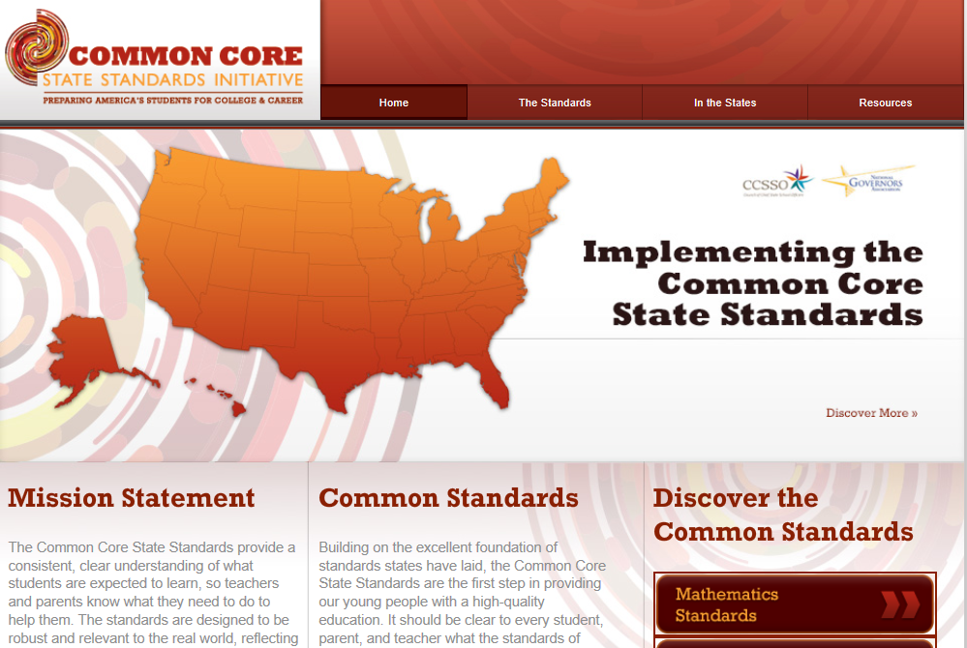
Corestandards.org

Slide 46
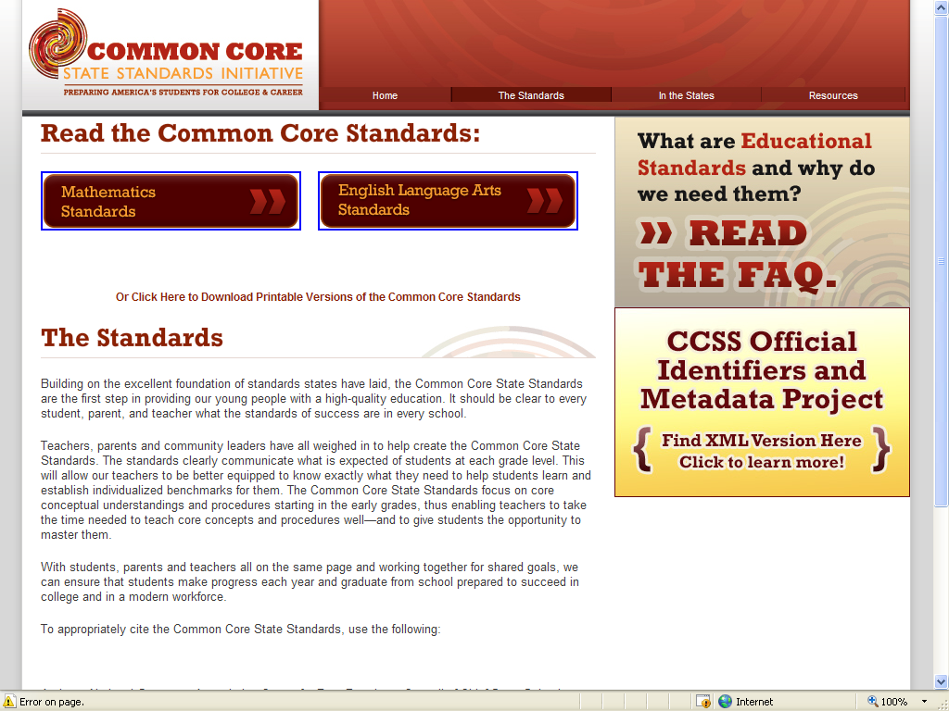

Slide 47
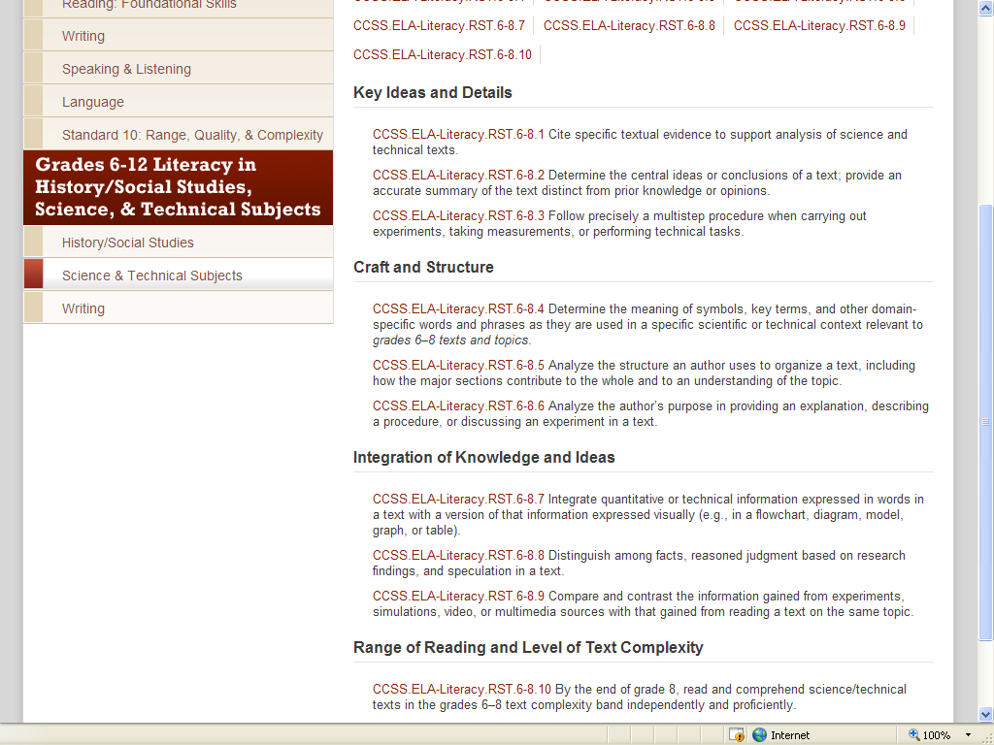
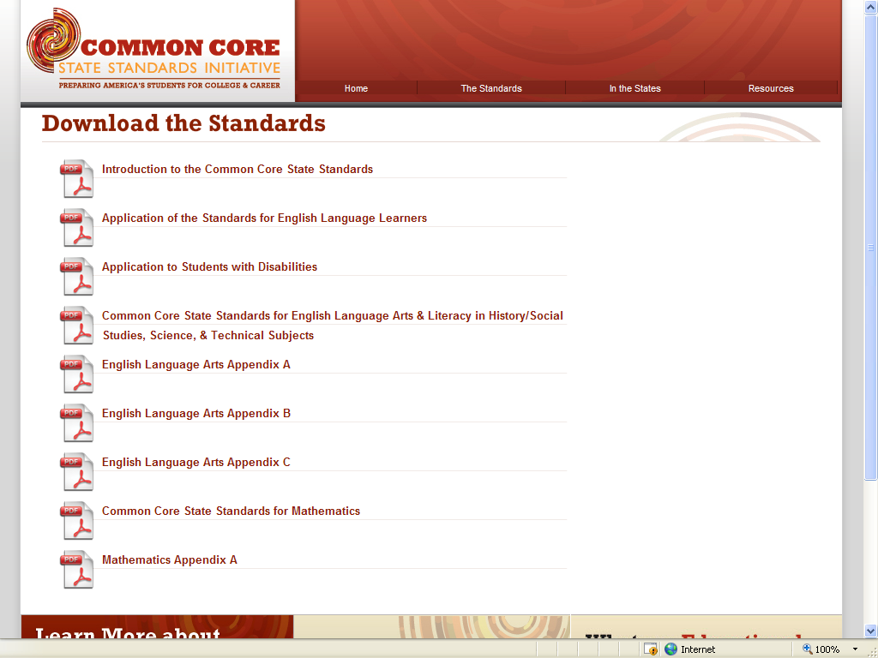
(Pages 62, 64-66)
(Pages 62, 64-66)

Slide 48
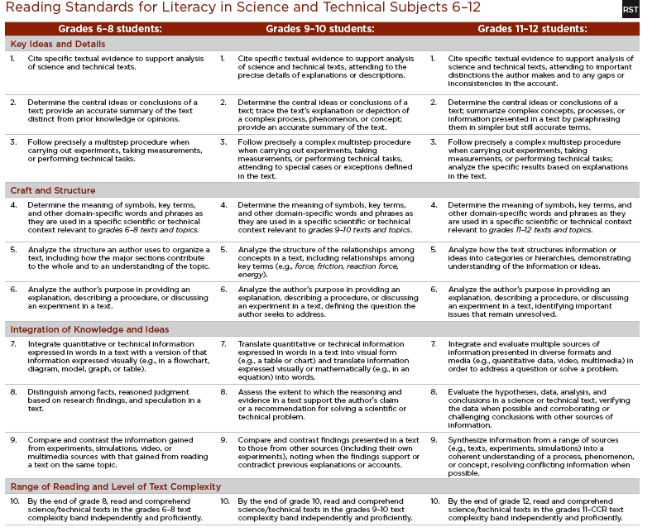

Slide 49
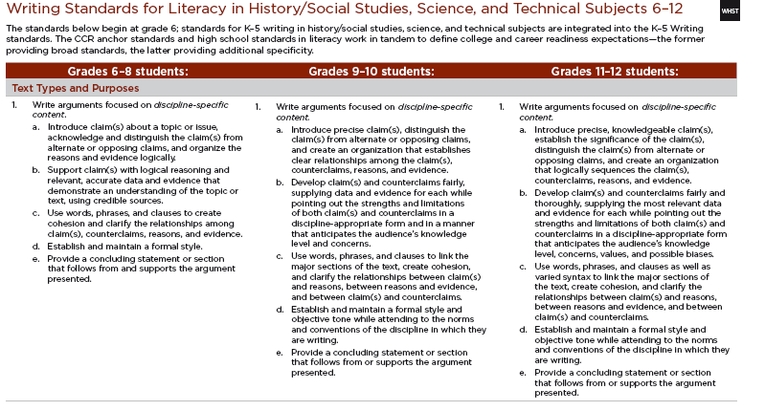

Slide 50
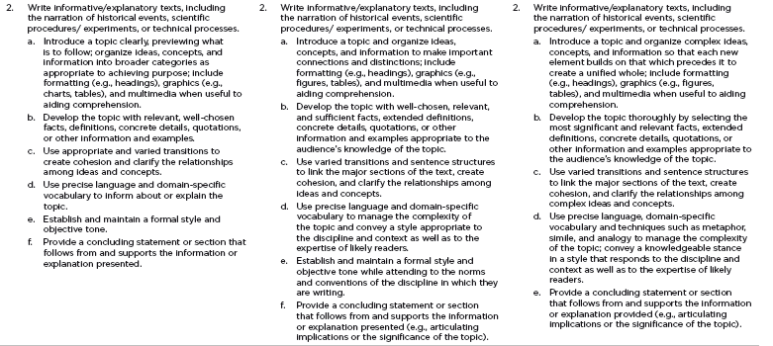

Slide 51
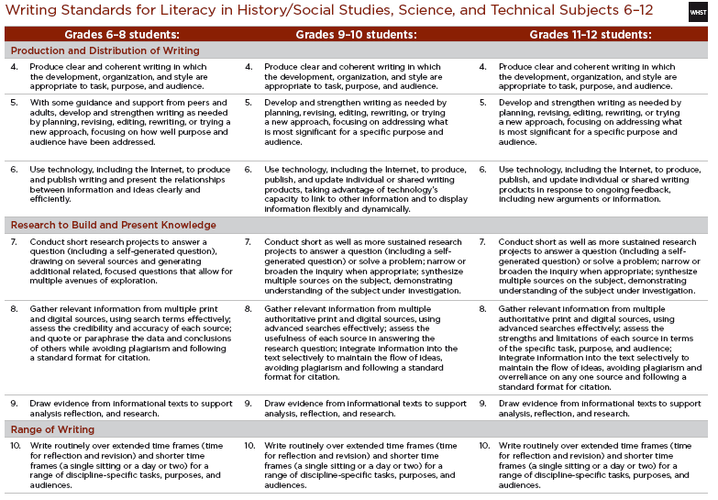

Slide 52
Florida’s Numbering of the Common Core State Standards
English Language Arts
LACC.910.RST.1.1
Subject Grade Domain Cluster Standard
For this example
Lang. Arts
9-10
Reading in Science & Technical Subjects
ONE
ONE

Slide 53
Florida’s Numbering of the Common Core State Standards
English Language Arts
LACC.1112.WHST.1.1
Subject Grade Domain Cluster Standard
For this example
Lang. Arts
11-12
Writing in History, Science & Technical Subjects
Text Types and Purposes
Standard 1

Slide 54
Digital Video Production Lesson Plan Sample
Title: | Digital Video Production 1
CTE Standards/Benchmarks: | 17.0 Demonstrate language arts knowledge and skills 17.01: Locate, comprehend and evaluate key elements of oral and written information. 17.02: Draft, revise, and edit written documents using correct grammar, punctuation and vocabulary. 17.03: Present information formally and informally for specific purposes and audiences. 18.0 Solve problems using critical thinking skills, creativity and Innovation 18.01 Employ critical thinking skills independently and in teams to solve problems and make decisions 24.0 Demonstrate leadership and teamwork skills needed to accomplish team goals and objectives 24.01 Employ leadership skills to accomplish organizational goals and objectives. LT1.0 24.02 Establish and maintain effective working relationships with others in order to accomplish objectives and tasks. LT3.0 24.03 Conduct and participate in meetings to accomplish work tasks
CCSS ELA & Literacy in History/Social Studies, Science, and Technical Subjects | LACC.910.WHST.2.4- Produce clear and coherent writing in which the development, organization, and style are appropriate to task, purpose, and audience. LACC.910.WHST.2.5- Develop and strengthen writing as needed by planning, revising, editing, rewriting, or trying a new approach, focusing on addressing what is most significant for a specific purpose and audience. LACC.910.WHST.2.6- Use technology, including the Internet, to produce, publish, and update individual or shared writing products, taking advantage of technology’s capacity to link to other information and to display information flexibly and dynamically.

Slide 55
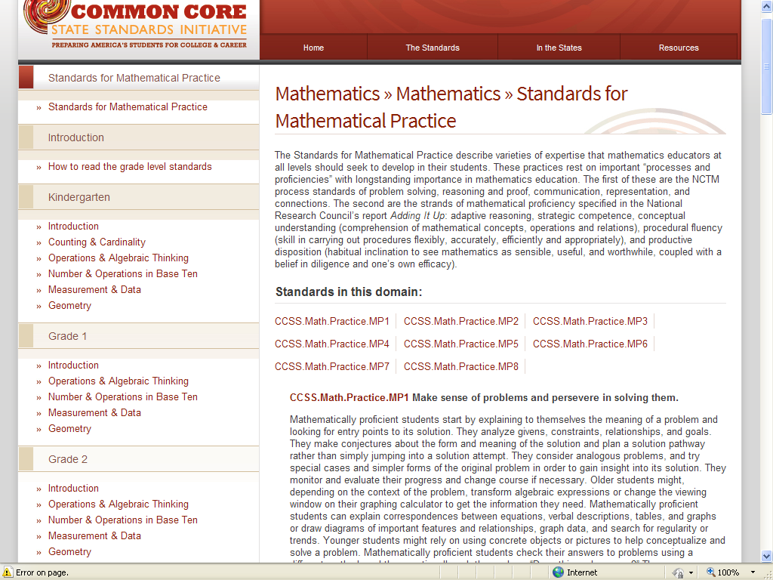
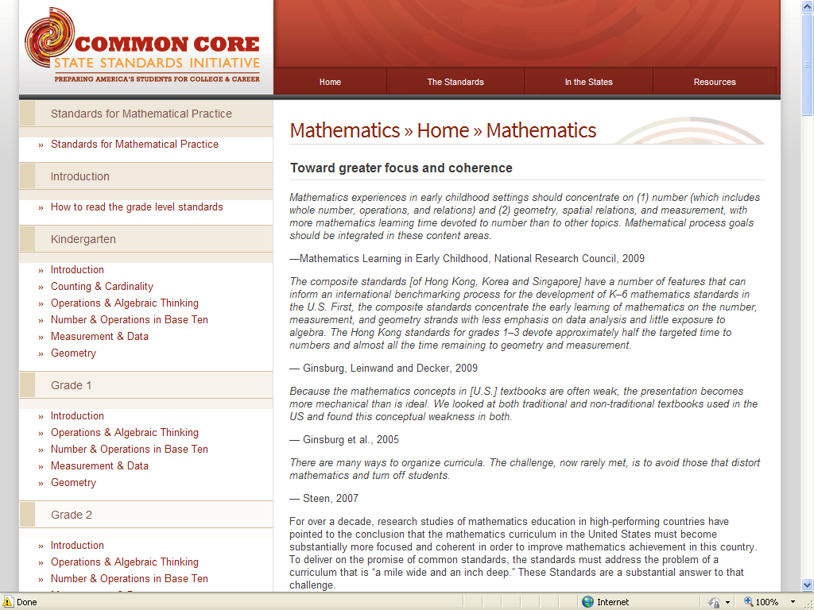

Slide 56
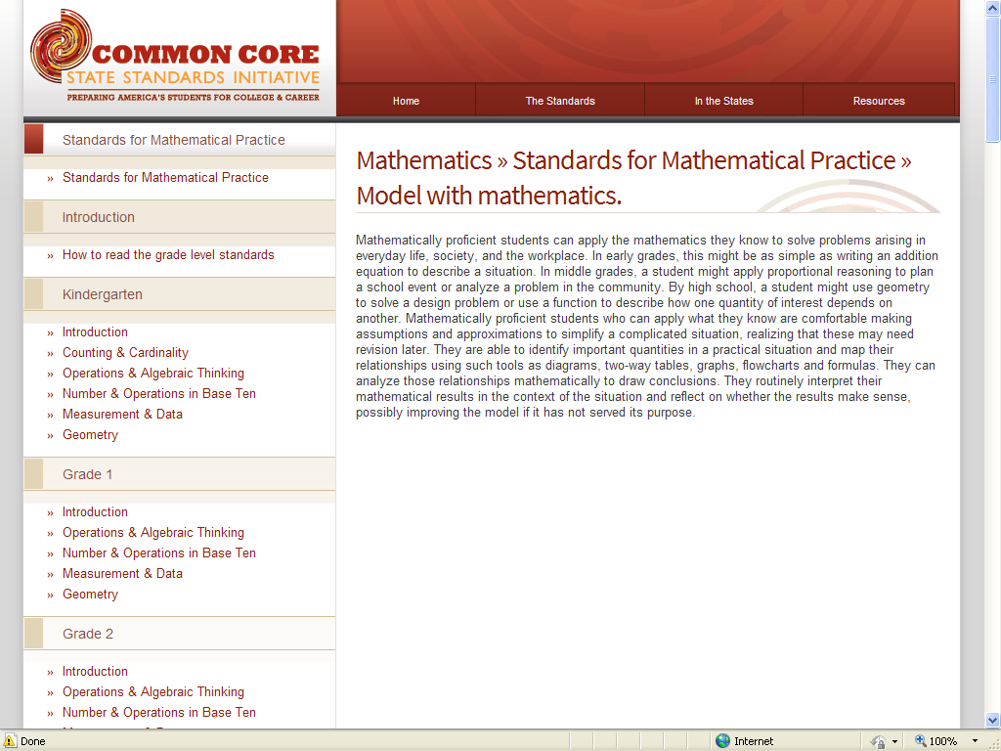
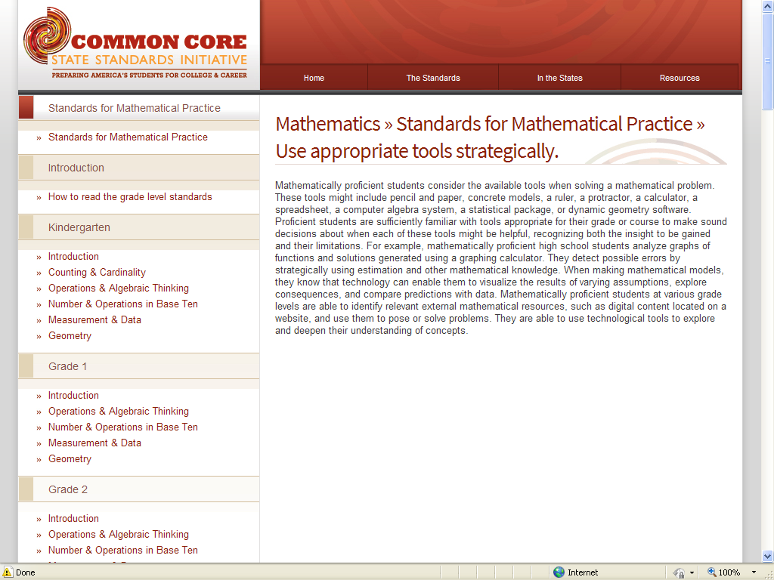

Slide 57
Florida’s Numbering of the Common Core State Standards
Mathematics
MACC.K12.MP.4.1
Subject Grade Domain Standard 5th digit for FL’s code system
For this example: Mathematics Common Core; Grades K-12;
Mathematical Practices; Model with mathematics.

Slide 58
Common Core State Standards for Mathematical Practice
  Make sense of problems and persevere in solving them
Use appropriate tools strategically
1
5
MACC.K12.MP.5.1
MACC.K12.MP.1.1
  Reason abstractly and quantitatively
Attend to precision
2
6
MACC.K12.MP.2.1
MACC.K12.MP.6.1
  Construct viable arguments and critique the reasoning of others
Look for and make sense of structure
3
7
MACC.K12.MP.3.1
MACC.K12.MP.7.1
  Model with mathematics
Look for and express regularity in repeated reasoning
4
8
MACC.K12.MP.4.1
MACC.K12.MP.8.1
Notes:
Presenter Directions
Say: These are the main headings for the Common Core Standards for Mathematical Practice. A description of each practice is included in the Common Core document beginning on page 6.
Stress that the Common Core Standards for Mathematical Practices do not stand alone and that they are not intended to be taught as stand alone lessons. The Common Core Standards for Mathematical Practices are an integral part of learning and doing mathematics and need to be taught with the same intention and attention as mathematical content.

Slide 59
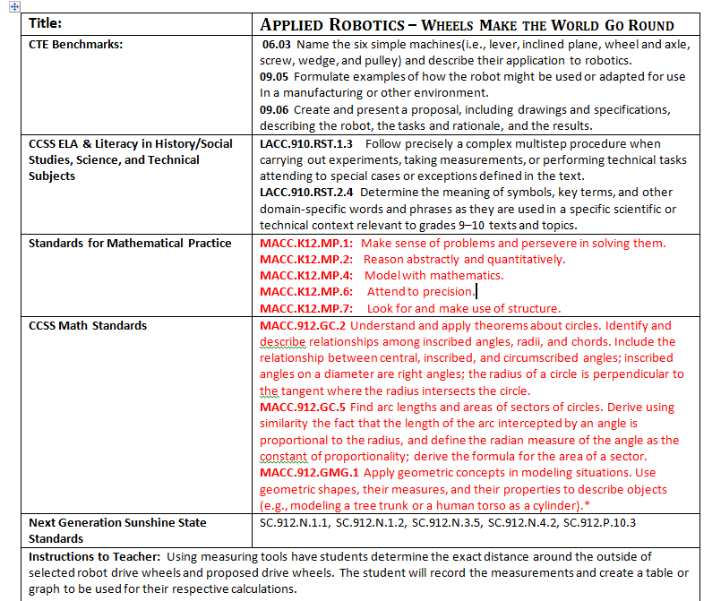
Robotics Lesson Plan Sample

Slide 60
Where Will CCSS “Live” in the CTE Frameworks?
6-8 ELA standards for technical subjects and applicable Standards for Mathematical Practice will be in the CTE courses designated as middle school courses
9-10 ELA standards for technical subjects and applicable Standards for Mathematical Practice will be in the 1st and 2nd CTE courses that make up the high school CTE programs
11-12 ELA standards for technical subjects and applicable Standards for Mathematical Practice will be in the 3rd and 4th CTE courses that make up the high school CTE programs
Notes:
Examples:
A student in a United States History course will learn the concepts relevant to that content, and also how to read historical texts critically. The student will learn to read and write like a historian.
A student in a Biology course will learn the concepts relevant to that content, and also how to integrate technical information from an experiment into a research project. The students will also learn to read and write like a scientist.
A student in a Three-Dimensional Studio Art course will learn the concepts relevant to that content, and also how to construct geometric figures.

Slide 61
Learning Goals and
Progression Scales

Slide 62
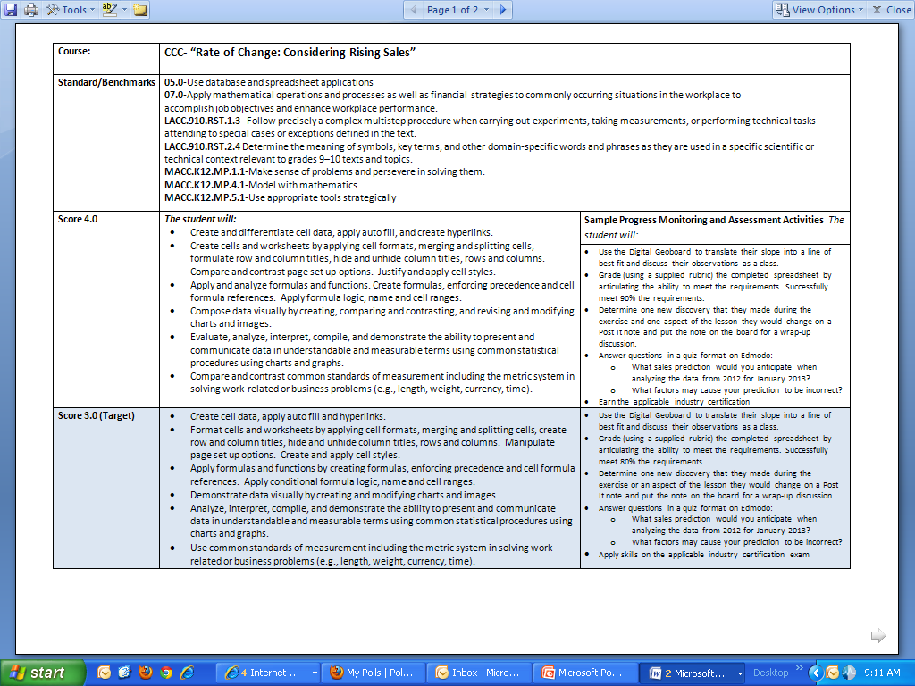
Learning Goals and Scales

Slide 63
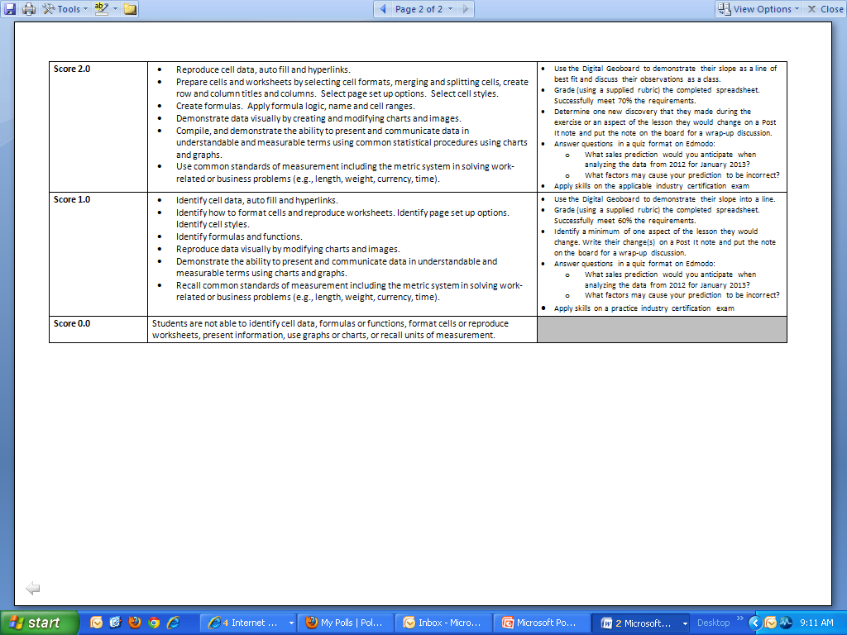

Slide 64

CTE and Academics

Slide 65
Standards-based Teaching and Learning
“The standards come alive when teachers study student work, collaborate with other teachers to improve their understanding of subjects and students’ thinking, and develop new approaches to teaching that are relevant and useful for them and their students.”
- Linda Darling-Hammond

Slide 66
Model for Instructional Planning
Frameworks
Identify the standards and benchmarks specific to the course.
Learning Goals
Define the major learning goals/targets based upon the critical areas of focus or big ideas along with the integrated standards from the course description.
Develop scales or rubrics to describe the steps students will take to attain each learning goal as well as what success looks like at each step.
Lesson Plans
Use the scales or rubrics to guide lesson development; include formative assessment tasks as part of the instructional plan, identify resources in advance, and incorporate the use of technology as a tool for learning when applicable.
Use the formative assessment data to revise and/or differentiate instruction as appropriate to meet the needs of ALL students.
Indicate alignments to core academics where applicable.
Include the Common Career Technical Core (CCTC) – by cluster.
Include alignments to national standards (if applicable).
Notes:
Florida’s Next Generation Sunshine State Standards and the Common Core State Standards were designed with a few “big ideas” or critical areas of focus (standards, enduring understandings, clusters, etc…) in mind. These “big ideas” are intended to guide instruction to a level that promotes a greater depth of understanding. If we only focus on the benchmarks or standards in isolation, we will loose the opportunity to promote that greater depth of understanding that is desired.

Slide 67
Professional Development
Highly recommended course from FACTE
Standards-Based Instruction for CTE
“Unpacking CTE Standards”
Assessments, and much more
Dates TBA

Slide 68

Standards Resources
CTE FRAMEWORKS are found on the DOE website.
  http://www.fldoe.org/workforce/dwdframe/
All other COURSE DESCRIPTIONS can be found on CPALMS. CPALMS is Florida’s Next Generation Sunshine State Standards and Common Core database.
    http://www.floridastandards.org
  Common Core State Standards for Mathematics and English Language Arts and Literacy in History/Social Studies, Science and Technical Subjects.
    http://www.corestandards.org/
Notes:
CPALMS is Florida’s standards database; soon it will include our interactive course code directory.

Slide 69
CTE and STEM

Slide 70

Focus on the
STEM and CORE

Slide 71

“We live in a time of vast changes that include accelerating globalization, mounting quantities of information, the dominating influence of science and technology, and the clash of civilizations. Those changes call for new ways of learning and thinking in school, business, and the professions.”
-Howard Gardner
Five Minds for the Future (2007)
http://www.corestandards.org

Slide 72

On the STEM and CORE
There is a path to a future filled with opportunities, with amazing individuals and extraordinary projects leading the way.

Slide 73
A body of knowledge
Seeks to describe and understand the natural world and its physical properties
Scientific knowledge can be used to make predictions
Science uses a process--the scientific method--to generate knowledge
The body of knowledge, systems, processes, and artifacts that result from engineering
Almost everything made by humans to solve a need or fulfill a want/desire is a technology
Examples of technology include pencils, shoes, cell phones, and processes to treat water
Science
Technology
“The science of quantity"
Seeks out patterns
Use of abstraction and logical reasoning
Involves the ability to explore, think through an issue, and reason logically to solve routine as well as non-routine problems
Design under constraint
Seeks solutions for societal problems and needs
Aims to produce the best solution given resources and constraints
Engineering uses a process--the engineering design process--to produce solutions and technologies
Engineering
Mathematics

Slide 74
STEM Education Attributes of a STEM Educated Student
Problem-solvers – define questions and problems, design investigations to gather data, collect and organize data, draw conclusions, and apply understandings to new and novel situations.
Innovators – creatively use science, mathematics, and technology concepts/principles by applying them to the engineering design process.
Inventors – recognize the needs of the world and creatively design, test, redesign, and then implement solutions (engineering process).
Self-reliant –use initiative and self-motivation to set agendas, develop and gain self-confidence, and work within time specified time frames.
Logical thinkers –apply rational and logical thought processes of science, mathematics, and engineering design to innovation /invention.
Technologically literate - explain the nature of technology, develop the skills needed, and apply technology appropriately.
Question to consider: How do these practices relate / link to the Common Core Literacy Standards and Standards for Mathematical Practice?
Morrison, Janice, 2006. TIES STEM education monograph series, attributes of STEM education.
Notes:
TIES: Teaching Institute for Excellence in STEM
Author was the recent STEM Advisor to the White House and U.S.D.O.E. and involved with the development of RTTT and Innovate to Educate reform programs.
GOAL – shift from isolated, discrete STEM disciplines to scientific understanding and reasoning.
Transdisciplinary STEM education: teaching from a STEM design perspective.
Problem solvers: According to cognitive learning theorists, play is the pre-cursor to problem-solving and questioning is central to play. Problem solvers argue from evidence – similar to CCSS for Literacy and Mathematical Practices.

Slide 75

Integration of Science & Engineering
Framework for K-12 Science Education
The Framework outlines the three dimensions that provide students with a context for the content of science, how science knowledge is acquired and understood, and how the sciences are connected through concepts that have universal meaning across the disciplines.
            Dimension 1: Practices
            Dimension 2: Crosscutting Concepts
            Dimension 3: Disciplinary Core Ideas
Notes:
D1: We use the term “practices” instead of a term such as “skills” to emphasize that engaging in scientific investigation requires not only skill but also knowledge that is specific to each practice.
Methods ➔ Processes ➔ Inquiry ➔ Practices (Habits of Mind)
Practice: doing something repeatedly in order to become proficient.
The expectation is that students will engage in the practices and not merely learn about them secondhand. Students cannot comprehend scientific practices, nor fully appreciate the nature of scientific knowledge itself, without directly experiencing those practices for themselves. ➔ second nature
D2: The framework’s structure also reflects discussions related to the NSTA Science Anchors project, which emphasized the need to consider not only disciplinary content but also the ideas and practices that cut across the science disciplines.
D3: Specifically, a core idea for K-12 science instruction should:
Have broad importance across multiple disciplines (Ecosystems: Interactions, Energy, and Dynamics, explores organisms’ interactions with each other and their physical environment) or be a key organizing principle of a single discipline (Biological Evolution – change over time).
Provide a key tool for understanding or investigating more complex ideas and solving problems.
Relate to the interests and life experiences of students or be connected to societal or personal concerns that require scientific or technological knowledge.
Be teachable and learnable over multiple grades at increasing levels of depth and sophistication (accessible to younger students but broad enough to sustain continued investigation over years).

Slide 76
A Framework for K-12 Science Education
Dimension 1: Practices
Integration of Science & Engineering
Asking questions (science) and defining problems (engineering)
Developing and using models
Planning and carrying out investigations
Analyzing and interpreting data
Using mathematics, information and computer technology, and computational thinking
Constructing explanations (science) and designing solutions (engineering)
Engaging in argument from evidence
Obtaining, evaluating, and communicating information
Notes:
A Framework for K-12 Science Education
Practices
The eight practices are essential elements of the K-12 science and engineering Curriculum. The K-12 practices are derived from those that scientists and engineers actually engage in as part of their work.
Students should be provided with opportunities to immerse themselves in these practices and to explore why they are central to science and engineering.

Slide 77
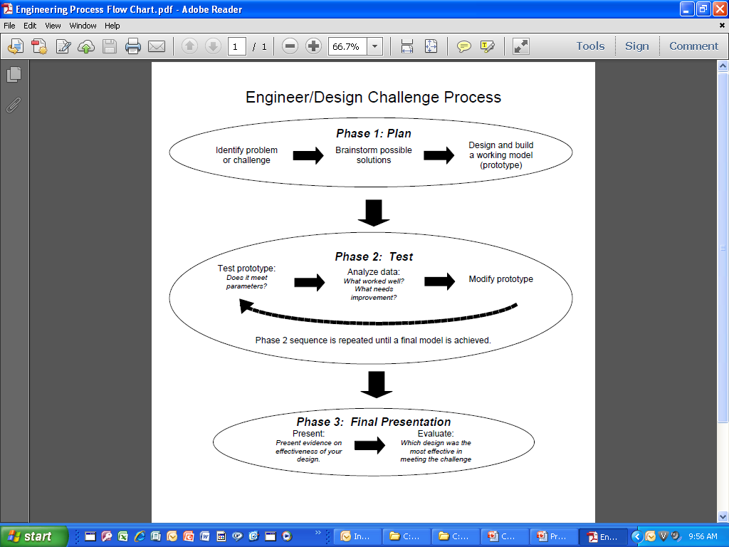
Engineering Process Flow Chart
Notes:
Share the Engineering Process Flow Chart. Explain that this is not the only process flow chart available. This was developed by teachers in Brevard County and is in over 20 CPALMS Engineering Design Challenges.
In Phase 1 (usually 1-2 days), students identify the challenge, brainstorm SEVERAL possible solutions, then select one and build a prototype. It’s important for them to brainstorm several possible solutions as it encourages all members of the team to contribute and leads to higher order thinking.
Once they have a prototype, they move to Phase 2. This is the test—analyze—modify phase that is critically important for developing higher order thinking skills. No prototype ever “fails.” There is always something that worked as planned and things that can be improved. The trick for teachers is getting the students to see what worked well. Most students focus on what didn’t work, but they can’t explain why something DID work—it’s a skill we need to encourage in our students. Another critical part of this phase is that the students CANNOT start over. They have to modify their original design, capitalizing on the things that worked well and modifying the things that need to be improved. The Engineering Report (to come later) is an important part of keeping track of modifications.
Finally, we get to Phase 3. Once students have a design that they think is as effective as it can possibly be, they present it at an Engineer’s Conference. This is where the ELA standards of speaking and listening can be met. All teams present their designs, along with evidence of effectiveness. Students evaluate each other’s designs and individually decide who’s design was most effective in meeting the challenge—stating the evidence that helped them make that decision.

Slide 78
Integration of Practices
Bridge disciplinary boundaries.
Help provide students with an organizational framework for connecting knowledge between disciplines.
Should be reinforced by repeated use in the context of instruction.
Should not be taught in isolation.
Helps students recognize the same concept is relevant across different contexts.
National Research Council. (2011 July). A Framework for K-12 Science Education: Practices, Crosscutting Concepts, and Core Ideas. National Academies Press. Washington, D.C. Retrieved from http://www.nap.edu/catalog.php?record_id=13165
Notes:
Although crosscutting concepts are fundamental to an understanding of science and engineering, students have often been expected to build such knowledge without any explicit instructional support. Hence the purpose of highlighting them is to elevate their role in the development of standards, curricula, instruction, and assessments.
These concepts should become common and familiar touchstones across the disciplines and grade levels. Explicit reference to the concepts, as well as their emergence in multiple disciplinary contexts, can help students develop a cumulative, coherent, and usable
Understanding of science and engineering.
Crosscutting concepts bridge disciplinary boundaries, having explanatory value throughout much of science and engineering.
The concepts help provide students with an organizational framework for connecting knowledge from the various disciplines into a coherent and scientifically based view of the world.
Students’ understanding of these crosscutting concepts should be reinforced by repeated use of them in the context of instruction in the science disciplines.
The crosscutting concepts can provide a connective structure that supports students’ understanding of sciences as disciplines and that facilitates their comprehension of the systems under study in particular disciplines.
The crosscutting concepts should not be taught in isolation.
Use of a common language for these concepts across disciplines will help students recognize that the same concept is relevant across different contexts.

Slide 79
Resources
Florida Common Core
  http://www.fldoe.org/schools/ccc.asp
Common Core State Standards for Mathematics
  http://www.corestandards.org
CPALMS
  http://www.floridastandards.org
  The Teaching Channel
  https://www.teachingchannel.org
  Inside Mathematics
  http://www.insidemathematics.org/index.php/common-core-standards
  NASA STEM Program
  http://search.nasa.gov/search/search.jsp?nasaInclude=STEM
  A Framework for K-12 Science Education (National Academies Press)
  http://www.nap.edu/catalog.php?record_id=13165
  Next Generation Science Standards
  http://www.nextgenscience.org/
  Teaching Institute for Excellence in STEM (TIES)
  http://www.tiesteach.org/about/
  PBS Teachers STEM Education Resource Center
  http://www.pbs.org/teachers/stem/
Illustrative Mathematics
  http://illustrativemathematics.org
  The STEM Education News
  http://www.trianglecoalition.org/tceb-info

Slide 80
FL-DOE Updates

Slide 81

2013 – 14
What’s NEW
Senate Bill 1076

Slide 82
Senate Bill 1076
The legislation takes steps to making sure Florida students have the skills for the jobs of the 21st century and ensure they can effectively compete for jobs in an ever competitive global economy. This legislation impacts Florida K-12 public school students by:
•Creating a pathway to a diploma that can be meaningful for students going on to college or a career by demonstrating the skills required for high school graduation, including earning national industry certifications in over 200 different professions, occupations and careers. This means students will be able to graduate from high school and have the qualifications to get a great job.
•Requiring financial literacy to be taught in our high schools so students have a better understanding of the risk of debt. Middle school students will now have the opportunity to study entrepreneurship.
•Teachers will be rewarded for student success by giving bonuses to teachers that provide direct instruction toward the attainment of industry certifications. This legislation also increases bonuses for teachers whose students achieve high scores on IB and AP exams.
This legislation impacts Florida higher education institutions by:
•Taking steps to ensure Florida's university system is focused on helping students obtain jobs.
•Providing Florida's colleges with the flexibility needed to provide bachelor's degrees for $10,000 or less in tuition.
•Directing the Board of Governors and the State Board of Education to create metrics that let Floridians know how well state universities and colleges are doing. Metrics include: percent of graduates employed or enrolled in further education, average wages of employed graduates and average cost per graduate.
http://www.fldoe.org/news/2013/2013_04_22.asp

Slide 83
2013-14 Changes
High School Diploma Designations
Scholar Designation – Students must satisfy additional course and assessment requirements.
•Merit Designation – Students must attain one or more industry certifications from the industry certification funding list pursuant to s.1003.492, F.S.

Slide 84
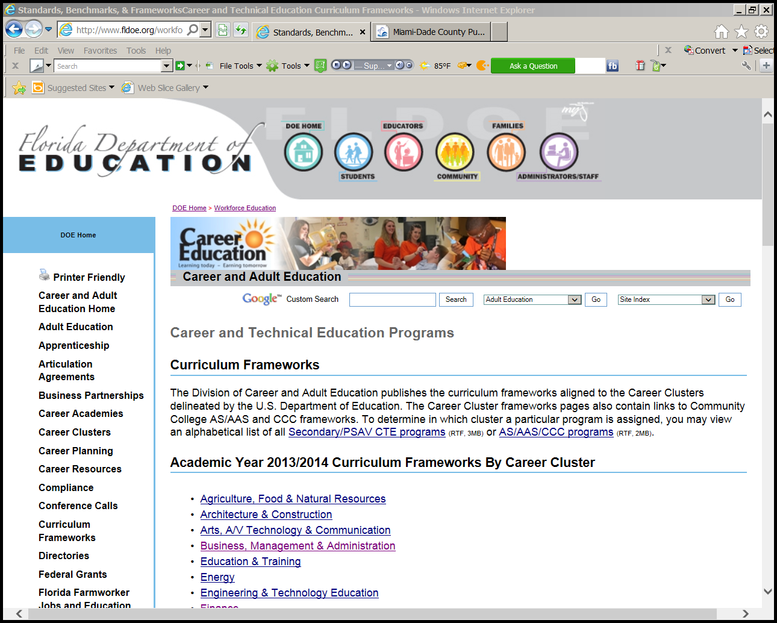
http://www.fldoe.org/workforce/dwdframe/

Slide 85
2012-13 ICE
Industry Certification Exams
Offered in Industrial & Technology Education
Programs Of Study
ADESK002 Autodesk Certified User – AutoCAD Passed 183
ADESK011 Autodesk Certified User – Autodesk Inventor Passed 109
ADESK016 Autodesk Certified Associate – AutoCAD Passed 10
ADESK020 Autodesk Certified Associate - Revit Architecture Passed 1
ADOBE010 Adobe Certified Associate – Dreamweaver Passed 3041
ADOBE011 Adobe Certified Associate – Flash Passed 383
ADOBE012 Adobe Certified Associate – Photoshop Passed 3374
ADOBE018 Adobe Certified Associate – Premier Pro Passed 75
CNCSI001 Mastercam Certified Programmer Mill Level 1 (CPgM1) Passed 13
CNCSI002 Mastercam Associate Certification - Mill Design and Toolpaths Passed 61
COMPT001 CompTIA A+ Passed 12
COMPT006 CompTIA Network+ Passed 2
COMPT008 CompTIA Security+ Passed 2
FLADA001 Florida Automobile Dealers Association (FADA) Certified Technician Passed 5
NCCER005 NCCER Carpentry Fundamentals -Level 1 Passed 194
NCCER008 NCCER Construction Technology Passed 4
NCCER032 NCCER Carpentry - Level 2 Passed 5
NCCER061 NCCER Welder - Level 1 Passed 5
NIASE010 ASE Automobile & Light Truck Certification - A1 - Engine Repair Passed 1
NINSC001 LabView Certification- The Associate Developer Passed 1
NRAEF003 Certified Food Protection Manager (ServSafe) Passed 885
SOLID001 Certified Solidworks Associate (CSWA) Passed 34
SOLID002 Certified Solidworks Professional (CSWP) Passed 10
Notes:
Failed Dream308 Photo1162 MOS 90

Slide 86
Teacher Bonus
For Student Achievement
of Industry Certification

Slide 87
Teacher Bonus – New Language
New Teacher Bonus Language added:
For industry certifications earned in the 2013-2014 school year and in subsequent years, the school district shall distribute to each classroom teacher who provided direct instruction toward the attainment of an industry certification that qualified for additional full-time equivalent membership under subparagraph 1.
a. A bonus in the amount of $25 for each student taught by a teacher who provided instruction in a course that led to the attainment of an industry certification on the Industry Certification Funding List with a weight of 0.1.
b. A bonus in the amount of $50 for each student taught by a teacher who provided instruction in a course that led to the attainment of an industry certification on the Industry Certification Funding List with a weight of 0.2.

Slide 88
Teacher Bonus – New Language
Bonuses awarded pursuant to this paragraph shall be provided to teachers who are employed by the district in the year in which the additional FTE membership calculation is included in the calculation.
Bonuses shall be calculated based upon the associated weight of an industry certification on the Industry Certification Funding List for the year in which the certification is earned by the student.
Any bonus awarded to a teacher under this paragraph may not exceed $2,000 in any given school year and is in addition to any regular wage or other bonus the teacher received or is scheduled to receive.

Slide 89
Teacher Bonus
For certifications earned 2013-14 and later
Applies to additional FTE funding received in the 2014-15 FEFP
A portion of the funds provided in s. 1011.62(1)(o), F.S. must be distributed in accordance with the new teacher bonus language

Slide 90
Teacher Bonus – Implementation Recommendation
Districts should be developing processes internally for identifying teachers whose instruction leads to the attainment of an industry certification.
All teachers whose instruction leads to the industry certification attainment must receive the bonus
This will be an issue for certifications that are end of program rather than end of course.
  The district will not be able to rely upon the teacher of record for the final course in which the certification was reported.

Slide 91
FAQ – Data Reporting
Q: Should my district report an industry certification attempt even if the student did not earn the certification?
A: Yes.
Q: If a student attempts to earn a certification more than once during the year, should the district report all attempts in their data reporting?
A: No. Only the final attempt and outcome should be reported.

Slide 92
FAQ – Data Reporting
Q: If a student earned an industry certification in a prior year and takes the latest version of the certification again, can the same certification be reported again in a subsequent year?
A: No. Once a certification code has been reported with student earning the certification, that certification code should not be reported again.

Slide 93
FAQ – Funding for Teacher Bonuses
Q: From what funds is the district provided the funding for the teacher?
A: The teacher bonus funds are provided in the add-on FTE calculation. There is not a separate source of funds for the teacher bonus. They must be paid out of the funding earned through the add-on FTE.

Slide 94
FAQ – School Grades
Q: Does the middle school grading formula include performances associated with the attainment of industry certifications on the Industry Certification Funding List?
A: Yes. For specific details, please see the school grades site: http://schoolgrades.fldoe.org or contact Ed Croft in the school grades office.

Slide 95
Web Resources
DOE Website – CAPE Act
  http://www.fldoe.org/workforce/fcpea/default.asp
Workforce Florida, Inc- Comprehensive Industry Certification List
  http://www.workforceflorida.com/PrioritiesInitiatives/EducationalInitiatives/cape.php
6A-6.0573, F.A.C.-- Industry Certification Process
  https://www.flrules.org/gateway/readFile.asp?sid=0&tid=7490357&type=1&file=6A-6.0573.doc
Industry Certification Descriptions https://app1.fldoe.org/WEIndCert/Default.aspx

Slide 96
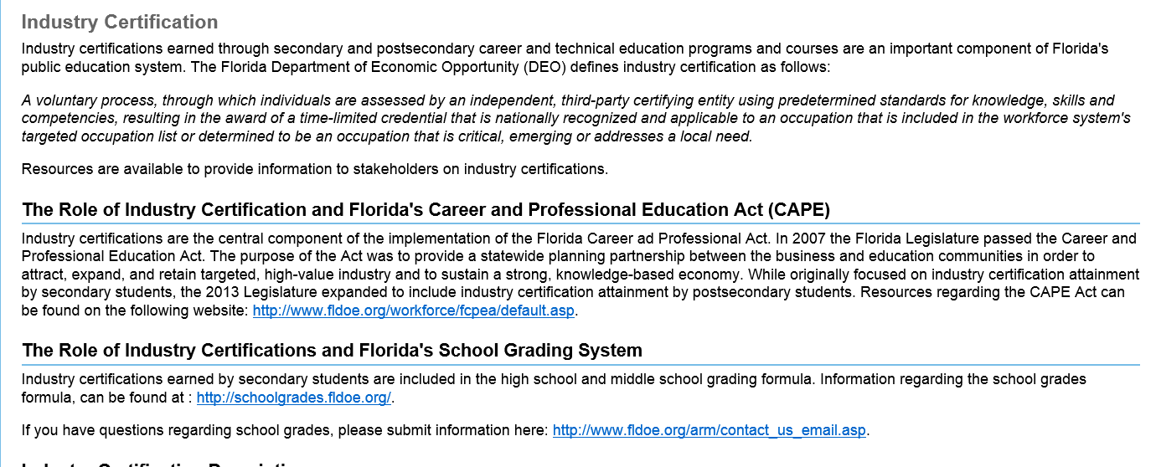
Web Resources
Re-designed Industry Certification Site
http://www.fldoe.org/workforce/indcert.asp

Slide 97
Career Education
(Program 300) in the FEFP
  s. 1011.62(1)(c), F.S. – The following language was added: The cost factor for secondary career education programs and basic programs grade 9 through 12 shall be equal.
Makes the weight for career equal to 9 through 12 basic
Career Education FTE will have to be reported as part of Group II, before FTE with the Basic 9-12 weight

Slide 98
Career Education
(Program 300) in the FEFP
Florida Education Finance Program
2013-14 Base Student Allocation: $3,752.30
Career Education Program Weight: 1.011 Equal to 9-12 Basic

Slide 99
2013-14 Implementation
CAREER AND PROFESSIONAL EDUCATION ACT (CAPE)

Slide 100

Summary of Policy Changes
Removal of Graduation/Promotion Requirement
Changes to the industry certification weighting methodology for 2013-14 list
Elimination of the Middle School STEM Industry Certification List
Limitation of funding to students in grades 9 through 12
Removal of academy participation from funding requirements

Slide 101

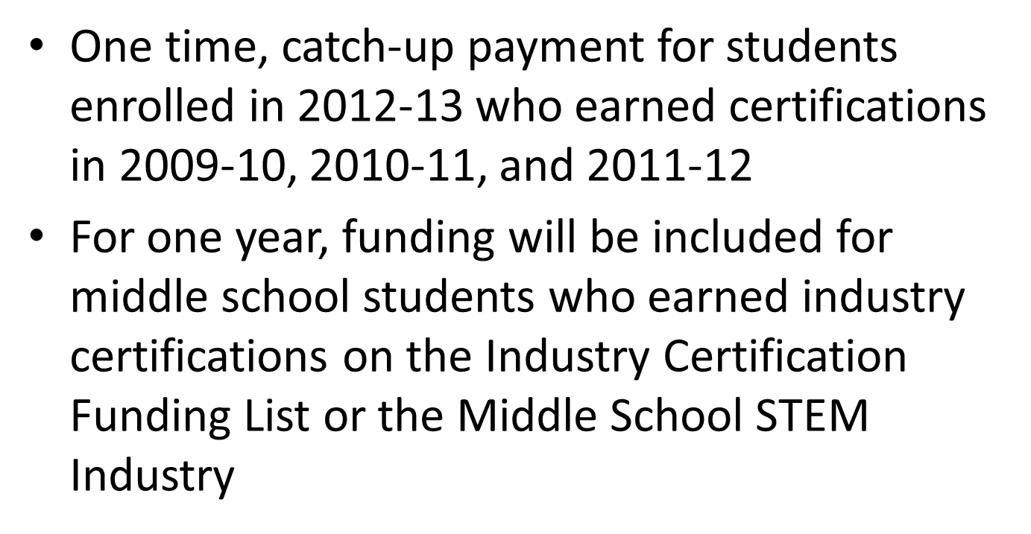

Slide 102

2013-14 FEFP Calculation (DRAFT)
Will include the following:
Add-on FTE for high school students earning industry certifications from the Industry Certification Funding List in 2012-13 Student must have been reported as enrolled in a registered career and professional academy from Appendix Y, or student must have earned a certification in a registered career-themed course from Appendix FF
Requirement for graduation is removed
Maximum funding of 0.3 per student
Add-on FTE for high school students enrolled in 2012-13 and who earned eligible certifications in 2009-10, 2010-11, and 2011-12 Include students who met all requirements for funding in 2009-10, 2010-11, and 2011-12 who were still enrolled in 2012-13, but who had not graduated from high school.

Slide 103
2014-15 FEFP Calculation
New weights for industry certifications on the Industry Certification Funding List based on presence of a statewide articulation agreement
-- 0.2 for certifications with an articulation agreement
-- 0.1 for all others
Add-on FTE calculated on an annual basis
NOTE: Students could max out on add-on FTE in one year Example: Student earned a certification with a weight of 0.1 and 0.2; funding provided in 2014-15 FEFP; this student could not be funded in subsequent years due to the 0.3 cap on funding per student

Slide 104
New language was added to prevent supplanting of funds from add-on FTE:
– Each district must allocate at least 80 percent of the funds provided for industry certification, in accordance with this paragraph, to the program that generated the funds. This allocation may not
be used to supplant funds provided for basic operation of the program.

Slide 105
Postsecondary Industry Certification Funding List
FACTE Conference 2013
Tara Goodman

Slide 106
Senate Bill 1076
Chapter 2013-27, Laws of Florida
http://flsenate.gov/Session/Bill/2013/1076
Comprehensive education bill included new sections related to postsecondary industry certification performance funding
Includes secondary and postsecondary changes to career and technical education

Slide 107
Statutes: s. 1008.44
(2) The State Board of Education shall approve, at least annually, the Postsecondary Industry Certification Funding List pursuant to this section. The commissioner shall recommend, at least annually, the Postsecondary Industry Certification Funding List to the State Board of Education and may at any time recommend adding certifications. The Chancellor of the State University System, the Chancellor of the Florida College System, and the Chancellor of Career and Adult Education shall work with local workforce boards, other postsecondary institutions, businesses, and industry to identify, create, and recommend to the commissioner industry certifications to be placed on the funding list. The list shall be used to determine annual performance funding distributions to school districts or Florida College System institutions as specified in ss. 1011.80 and 1011.81, respectively. The chancellors shall review results of the economic security report of employment and earning outcomes produced annually pursuant to s. 445.007 when determining recommended certifications for the list, as well as other reports and indicators available regarding certification needs.

Slide 108
Statutes: s. 1011.80 for district workforce education
(6)(b) Performance funding for industry certifications for school district workforce education programs is contingent upon specific appropriation in the General Appropriations Act and shall be determined as follows:
  1. Occupational areas for which industry certifications may be earned, as established in the General Appropriations Act, are eligible for performance funding. Priority shall be given to the occupational areas emphasized in state, national, or corporate grants provided to Florida educational institutions.
  2. The Chancellor of Career and Adult Education shall identify the industry certifications eligible for funding on the Postsecondary Industry Certification Funding List approved by the State Board of Education pursuant to s. 1008.44, F.S., based on the occupational areas specified in the General Appropriations Act.
  3. Each school district shall be provided $1,000 for each industry certification earned by a workforce education student……If funds are insufficient to fully fund the calculated total award, such funds shall be prorated.
Similar language for colleges in s. 1011.81, F.S.

Slide 109
Postsecondary Industry Certification Funding
$1,000 per eligible certification
Dual enrollment students will be included in the calculation
Funding for 2013-14 is to be provided based on certifications earned in the 2013-14 academic year
  Mid-year allocations

Slide 110
Statutes – 2013 Appropriations Act
Districts: Specific Appropriation 115 = 4,982,722
Funds in Specific Appropriation 115 shall be provided by the Department of Education to district workforce education programs for students who earn industry certifications during the 2013-2014 fiscal year. Funding shall be based on students who earn industry certifications in the following occupational areas: automotive service technology, cyber security, cloud virtualization, advanced manufacturing, and welding; or, industry certifications for Federal Aviation Administration airframe mechanics and power plant mechanics; pharmacy technicians; and heating, ventilation and air conditioning technicians. On June 1, 2014, if any funds remain, the balance shall be allocated based on each district's share of the targeted career and technical education funding provided in Specific Appropriation 117A and shall be spent for the purpose of that appropriation.

Slide 111
Targeted Occupational Areas
Industry certifications in the following areas:
  Automotive Service Technology
  Cyber Security
  Cloud Virtualization
  Advanced Manufacturing
  Welding
  Federal Aviation Administration airframe mechanics and power plant mechanics
  Pharmacy technicians
  Heating, ventilation and air conditioning technicians

Slide 112
Postsecondary Industry Certification Funding – Implementation Plan
Division of Career and Adult Education will work with the Florida College System on the adoption of the “Postsecondary Industry Certification Funding List”, as specified in a new section of law (s. 1008.44, F.S.)
Planning for an initial list to be adopted by the State Board of Education by the October 2013 meeting

Slide 113
Postsecondary Industry Certification Funding – Implementation Plan
From the Postsecondary Industry Certification Funding List, the Chancellors of the Division of Career and Adult Education and the Florida College System will need to identify the certifications eligible for funding in the occupational areas identified in the General Appropriations Act
Please contact John Holdnak for specific details about the college implementation plan for the appropriation itself

Slide 114
State Board Rule Adoption
Will be Rule 6A-6.0574
Rule development notice posted here:
https://app1.fldoe.org/rules/default.aspx

Slide 115
Eligibility for District Funding
Student must have been enrolled in the 2013-14 year
Program Enrollments must be in the following areas:
  Career Certificate
  Applied Technology Diploma
  Apprenticeship
Unresolved issue: FLDOE is seeking guidance from Governor’s office on whether students in continuing workforce education programs are eligible to generate bonus

Slide 116
Dual Enrollment Students
Dual enrollment students may generate the bonus
Students enrolled in eligible programs as dual enrollment students must be reported in the postsecondary reporting system
  Data WILL NOT be generated from the K-12 system for this allocation

Slide 117
District Postsecondary Industry Certification Funding – DRAFT Implementation Plan
Calculation will be updated three times in the 2013-14 Fiscal Year
Allocation Calculation | Timing | Basis for the Calculation
Calculation 1 | Late October 2013 | Industry certification activity reported in Survey F
Calculation 2 | March 2014 | Industry certification activity reported in Survey W, plus any updates to F
Calculation 3 | May 2014 | Industry certification activity reported in Survey S, plus any updates to F and W (Open date for S will be moved up). Pro-ration of remaining funds based on targeted CTE funding allocation

Slide 118
Use of Funds
s. 1011.80(7)(a) A school district or Florida College System institution that receives workforce education funds must use the money to benefit the workforce education programs it provides. The money may be used for equipment upgrades, program expansions, or any other use that would result in workforce education program improvement. The district school board or Florida College System institution board of trustees may not withhold any portion of the performance funding for indirect costs.

Slide 119
District Data Reporting
Only data reported in the 2013-14 year will be used
Survey F (Summer 2013)
Survey W (Fall 2013)
Prelim Survey S (Spring 2013)
  The data reporting for this file will have to cut-off around mid- to late May 2014 so that the final calculation can be run

Slide 120
Data Reports for Review
We will be working on data reports that will accompany the funding calculation to be delivered in a secure method to districts

Slide 121
Other Issues
Frequently Asked Questions:
Are there teacher bonuses that must be paid out of these funds?
  No statutory requirement for teacher bonuses from the postsecondary funds
Do the funds go the high school for the dual enrolled students?
  The funds are provided to the district for the benefit of postsecondary workforce education program (see s. 1011.80)

Slide 122
CTE Professional Assocations

Slide 123
Professional Assocations
ITEEA
FACTE
FATIE
FTEEA
TRAVEL

Slide 124
M-DCPS CTE Policies & Procedures

Slide 125
Policies & Procedures
Safety
Equipment Repair & Request Forms
Marketing
CTE Transition Specialists

Slide 126
Resources from Workshop
Technology and Industrial Education Updates Fall 2013 Workshop links: http://teched.dadeschools.net/workshopAug2013.html
Industry Certification Resources and Links for Secondary & Postsecondary: http://teched.dadeschools.net/Certification.htm

Slide 127

Contact information
9600 – Office of Career & Technical Education
7601 – Turner Technical Arts High School
10151 N.W. 19th Avenue, Office 009
Miami, FL 33147
(305) 693-3018 (305) 696-9346 fax
http://stem.dadeschools.net
http://dcte.dadeschools.net

